Slide 1
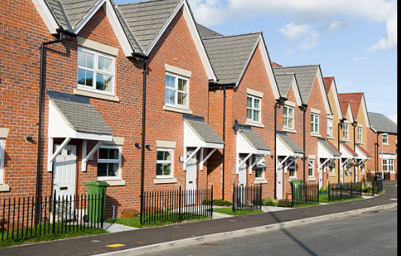



Slide 2

Executive Summary
Our first mission, is by far the most important and that is to create and offer suitable, affordable homes for a variety of individuals and families. ​We know how important it is to have somewhere to call home that feels comfortable and secure.
We are professional property investors, with a wealth of knowledge. Whelan Property is a full turnkey company, carrying out all refurbishments, and investments. This will ensure full continuity to potential external investors, knowing they have one dedicated contact for the duration of their investment.

Slide 3
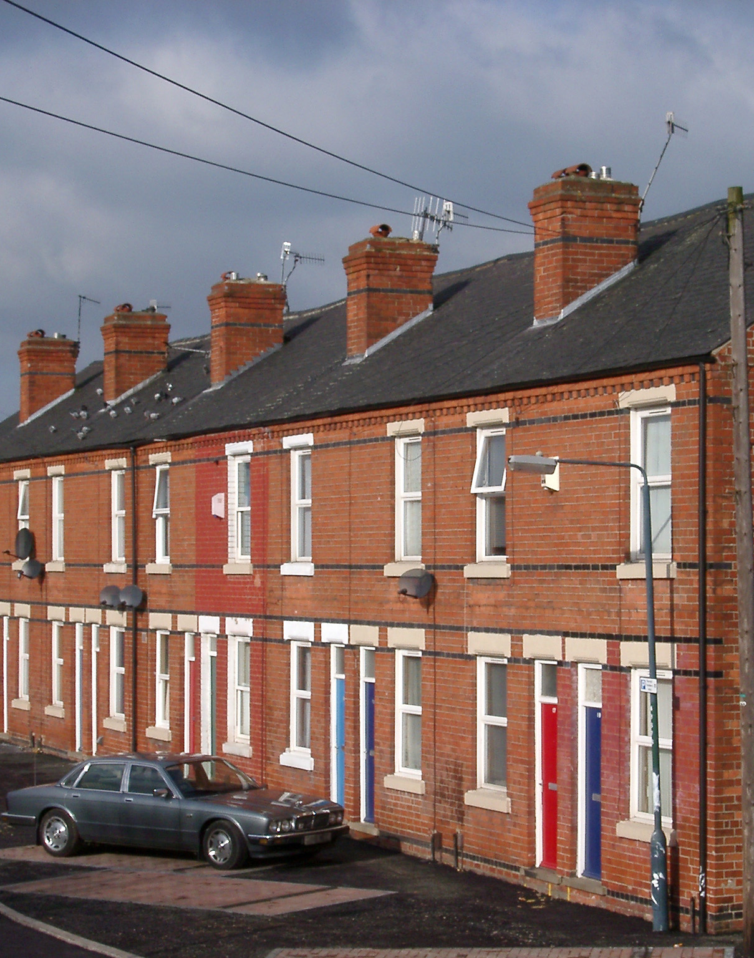
Our Vision & Values
Vision Statement
To create a future where every individual has access to affordable, sustainable and dignified housing – we aim to transform social housing into a cornerstone of thriving, resilient communities, where everyone can live well and contribute to the sustainable world.
Affordability: A continued focus on accessible social housing
Sustainability: Commitment to eco-friendly practises and environmental goals
Community Resilience: Building homes that foster strong and healthy communities
Dignity and Inclusivity: Creating homes that respect and support diverse needs

Slide 4
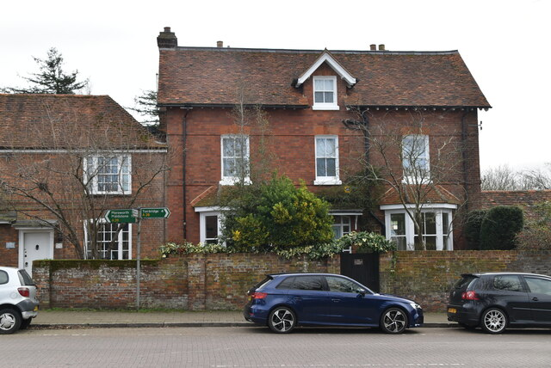




Why invest in Property over other assets?
It stands the test of time
Property consistently grows in value and appreciates over time. Property has proven to be a reliable and stable option, unlike other volatile methods of investment
8/10 Millionaires invest in Property
Property is the world’s largest store of wealth – “real estate outshines all other asset classes in its steadfast ability to amass wealth” (Forbes)
It protects against inflation
During periods of high inflation, like post-covid, tangible assets like property tend to perform extremely well and has a strong track record of hedging against inflation
It provides multiple streams of wealth
It’s not just rent and capital appreciation you benefit from: we add additional value through renovation which increases the end figure, which allows higher refinance whilst retaining the asset in portfolio. (BRR).

Slide 5
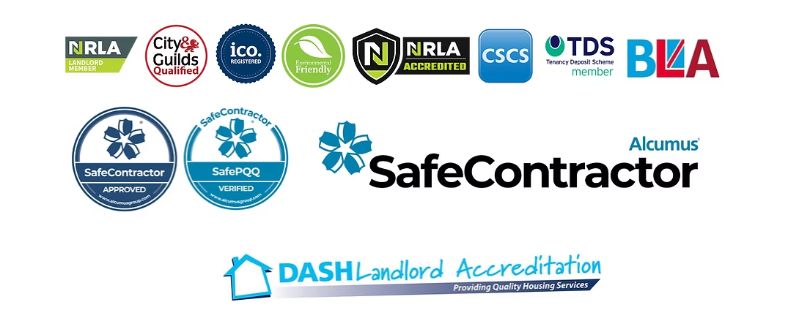
Company Profile & Strategy
We have a proven track record of successfully renovating 2–5-bedroom houses in the across the country. These are all transformed in house with our own ‘Power Team’.
These are then fixed on long lets to Private Tenants or Social Housing providers that we have long standing relationships with,
We generally secure the properties through a variety of methods; Open Market, Auction or through our contacts.
When letting to Social Housing providers, they are responsible for all maintenance, and the rent is paid regardless of occupancy levels. This means once the renovations are complete, the investments are truly hands free & passive.
We have our own ‘Power Team’ which that deliver the projects to a high standard ensuring compliance to all regulation. (Including finance, legals & compliance).
We are proud members of the following bodies;

Slide 6
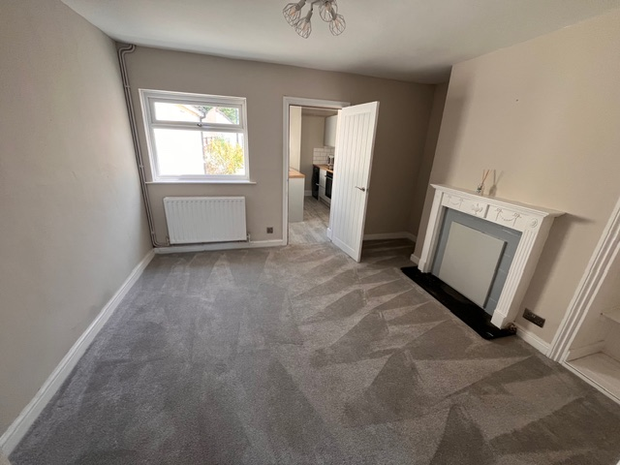
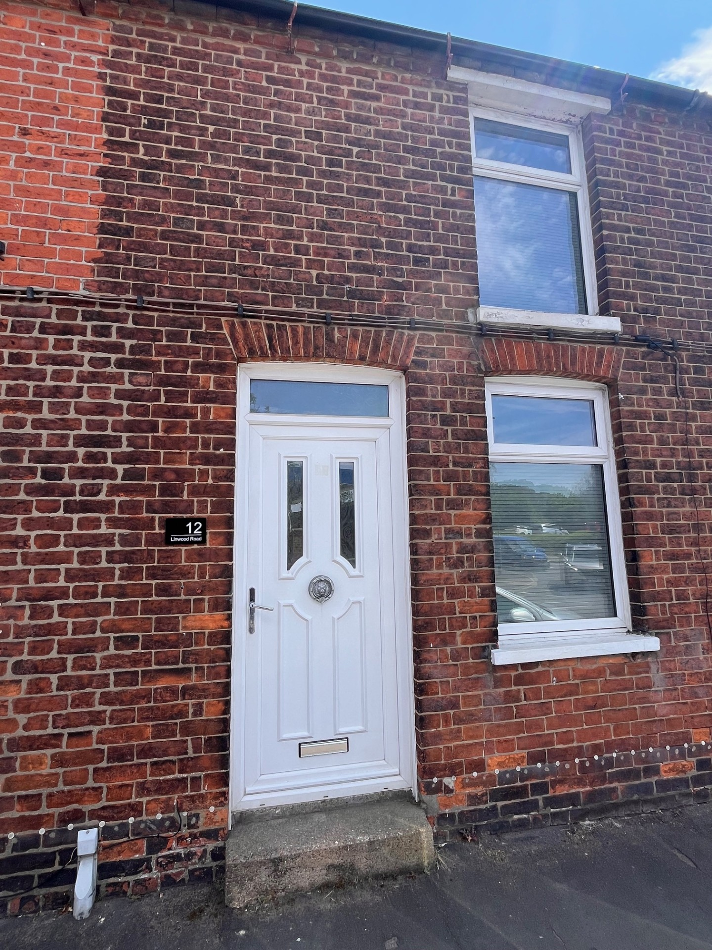
Case Study:
12 Linwood Road, Market Rasen. LN8 3AN
Property secured direct to vendor for £85,000.
In house build team executed major refurb for £8,000
Monthly Rental agreed £775/pcm.
Property refinanced for £135,000, which released capital to purchase another BRR.

Slide 7
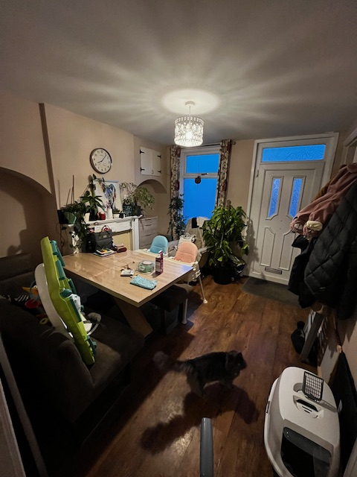
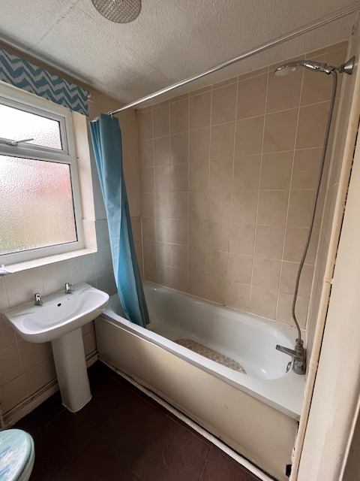
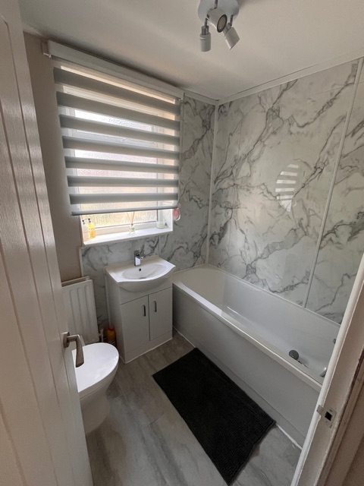
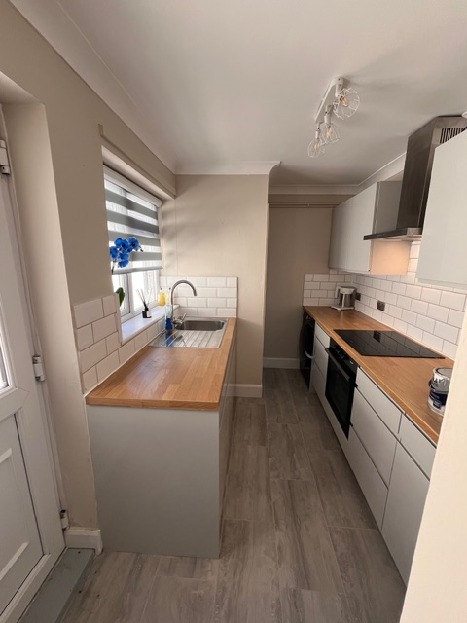
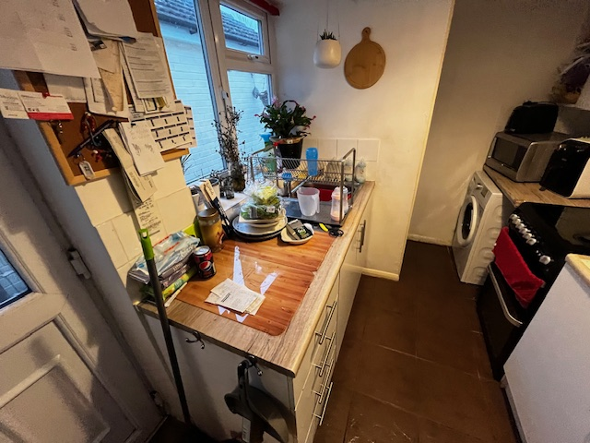
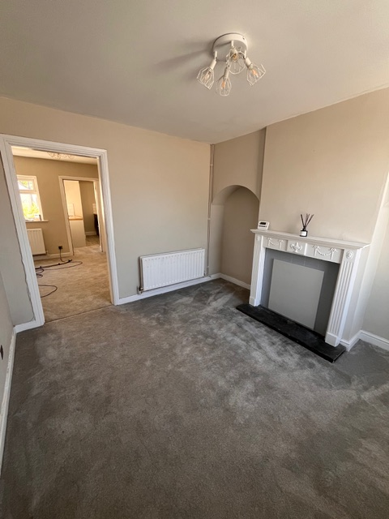
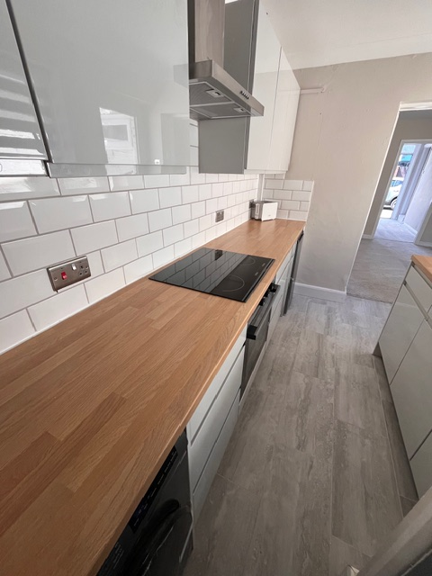
AFTER
Before

Slide 8
Investment Offering
We are constantly in the process of buying a variety of properties across the country, including a push in the Grimsby area. But other areas of investment are the South Coast (Portsmouth, Southampton etc). We aim to build strong relationships with estate agents, and/or we target deals which are off-market (Direct to Vendor).
We have the capability to move fast, and complete deals quick with our strong ‘Power Team’.
We target properties that require a full back to brick refurbishment to be brought up to a compliant regulation/standard. We also look to enhance our properties by reconfiguring them internally to allow for us to maximise the end value when it comes to refinance.
We are seeking investment to support us in our ever-expanding portfolio and enable us to bring these properties back to life whilst providing homes for those most in need.
(Investment applications are only processed upon completion of initial suitability questionnaire having passed prior).
Investment Level | Length of Investment | Interest Paid | Length of Investment | Interest Paid
£10,000 - £50,000 | 12 months | 8% | 24 months | 10%
£50,001 - £100,000 | 12 months | 10% | 24 months | 11%
£100,001 - £250,000 | 12 months | 11% | 24 months | 12%
£250,001+ | 12 months | 12% | 24 months | TBD

Slide 9

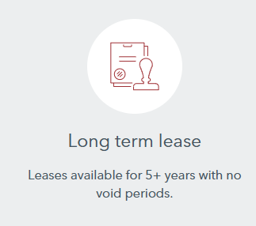
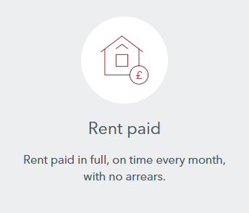
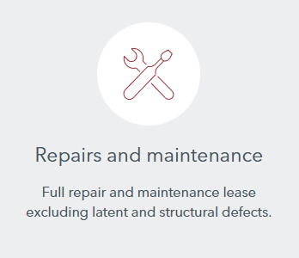

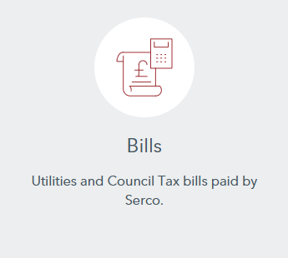
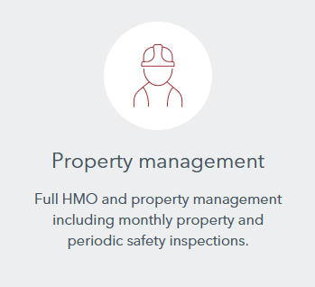
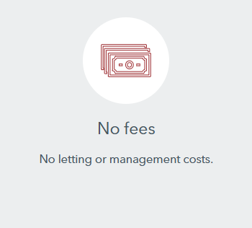

Investment Partners

Slide 10








Contact Details:
Whelan Property Ltd,
James Carter Road,
Bury St. Edmunds.
IP28 7DE
+44(0)7482240499
info@whelanproperty.com
www.whelanproperty.co.uk

